Slide 1
Islamicate Aesthetics/Islamicate Cosmopolitanism
Bruce B Lawrence
Keynote Address for
Duke-UNC Graduate Students Conference
21 March 2015
Imagining the Beautiful:
Theories and Practices of Meaning in Islamicate Aesthetics

Slide 2
Summary of Paradox
Can one produce a book that is Islamicate/Persianate in substance but not in name?
2 museum catalogues, and 1 coffee table book -- all three are Islamicate/Persianate in tone, evidence, and argument, yet none mentions by name either Marshall Hodgson or Islamicate/Persianate as categories of analysis.

Slide 3
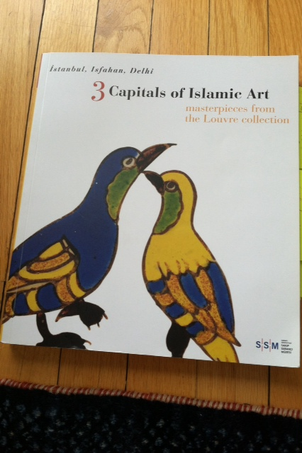
Islamicate Art: Timurid origins of embedded cosmopolitanism

Slide 4
Istanbul, Isfahan and Delhi
Objects from the Louvre collection in Paris on display in Istanbul at Sakıp Sabancı Müzesi in 2008 under the title, 3 Capitals of Islamic Art

Slide 5
Birds do it

Slide 6
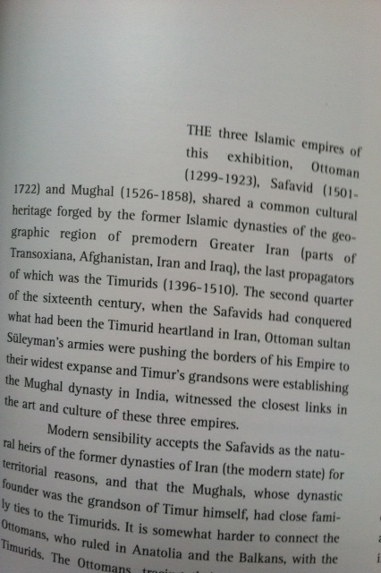
Three post-Timurid empires

Slide 7
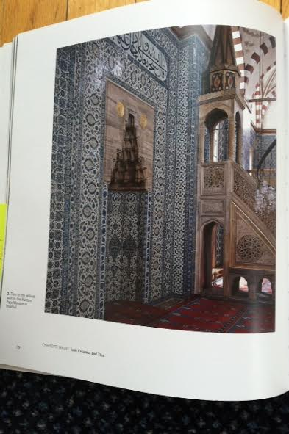
Rustam Pasha mosque, Istanbul

Slide 8
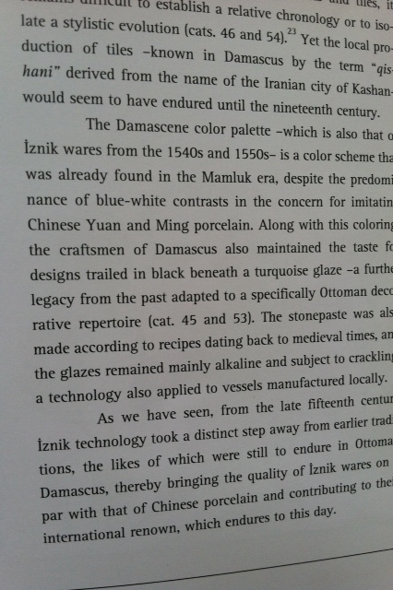
Syria-Egypt-China-Turkey-India-Iran

Slide 9
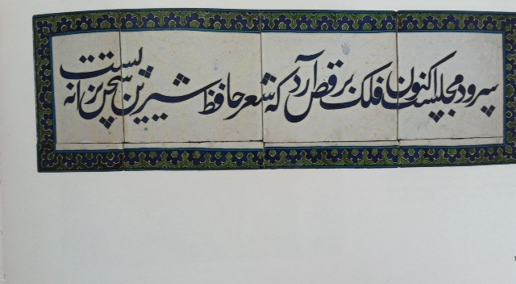
Syrian Ottoman Persian(ate) tile

Slide 10
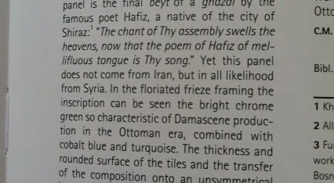
Cosmic lyrics, from Iran, Syria, Turkey

Slide 11
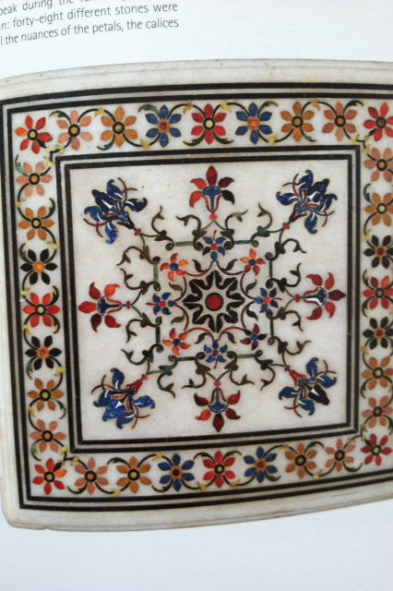
Taj Mahal tile

Slide 12
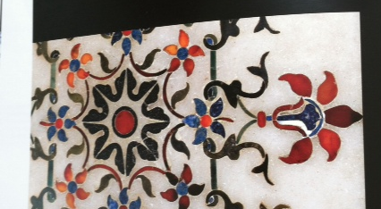
Taj Mahal tile close up

Slide 13
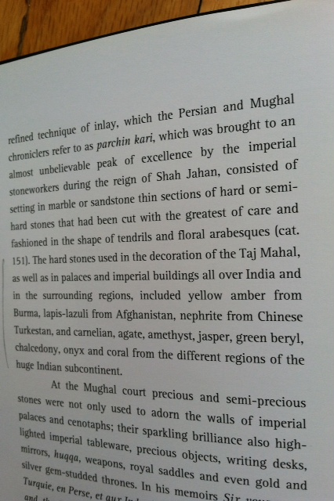
Burma, Afghanistan, China

Slide 14
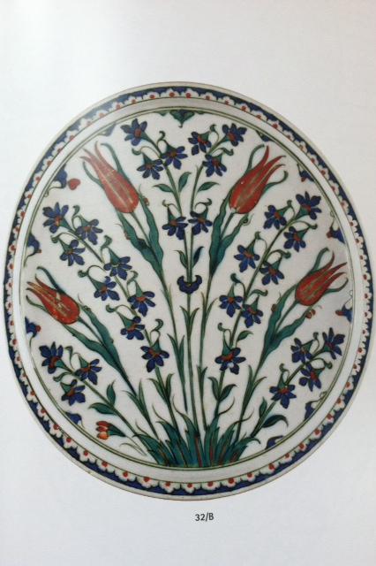
Tulips triumph

Slide 15
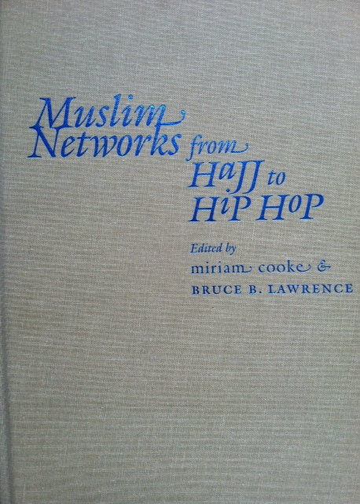
Islamicate networks

Slide 16
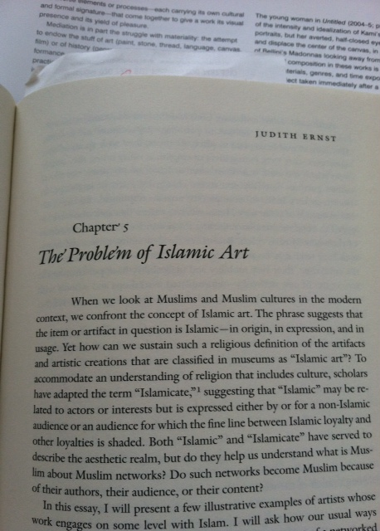
Interlude –
Judith Ernst got it right, but with few successors

Slide 17
A footnote to Judith Ernst: from Beyond Turk and Hindu
For those of you who may have missed it, the importance of Islamicate was stressed in a 2000 book, from a 1995 conference, co-edited by David Gilmartin and me: Beyond Turk and Hindu: Rethinking Religious Identities in Islamicate South Asia.
Here is the relevant quote: “Coined by Marshall Hodgson in the mid-60s, Islamicate denotes the moral values and cultural forms that spread through the world system of Muslim trade and power in the centuries following the rise of Islamic polities…Although Muslims did not make this distinction – they had no need to – the distinction between Islamicate and Islamic/Muslim is extremely useful for us – moderns, or perhaps post-moderns, that we be…Especially in South Asia the term Islamicate captures the civilizational dynamic for the framing of religious identities (including architectural tastes and choices, as analyzed by Catherine Asher in her chapter, “Mapping Hindu-Muslim Identities through the Architecture of Shahjahanabad and Jaipur”) [pp. 3, 10, 121-148]

Slide 18
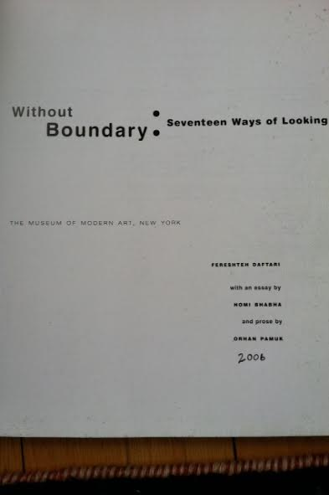
Museum Catalogue # 2-
Without Boundary but also without Islamicate

Slide 19
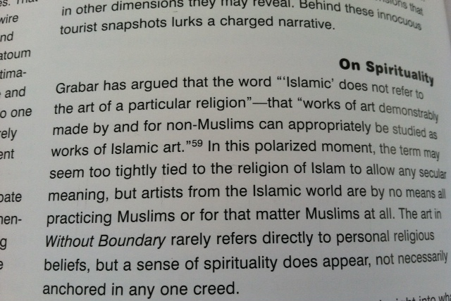
Daftary quoting Grabar (1973) but not Hodgson (1974)

Slide 20
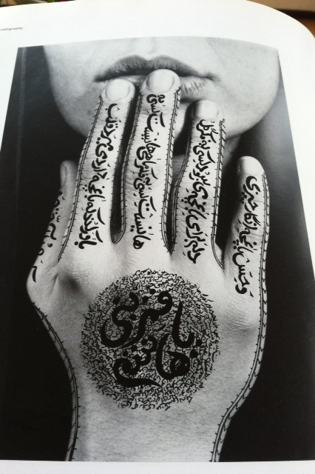
Shirin Neshat # 1

Slide 21
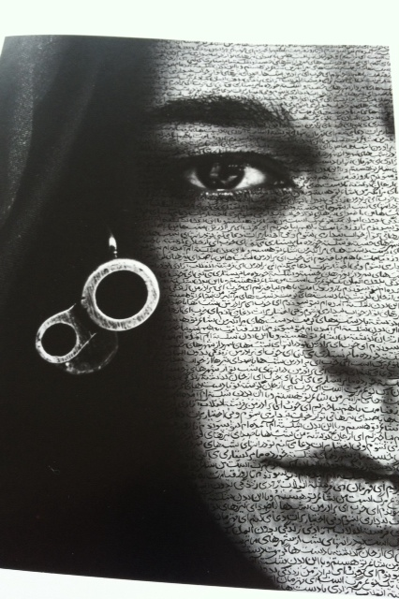
Shirin Neshat # 2

Slide 22
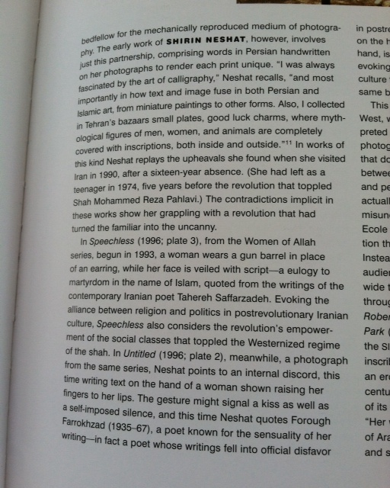
Shirin Neshat Islamicate cosmopolitan

Slide 23
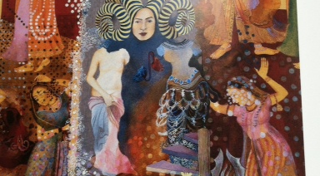
Shahzia Sikander also Islamicate cosmopolitan

Slide 24
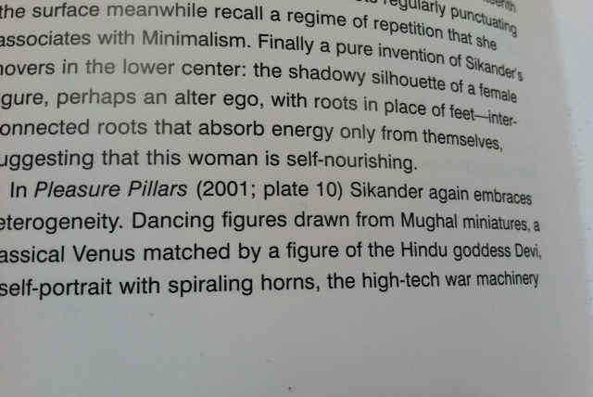
Background on Sikander

Slide 25
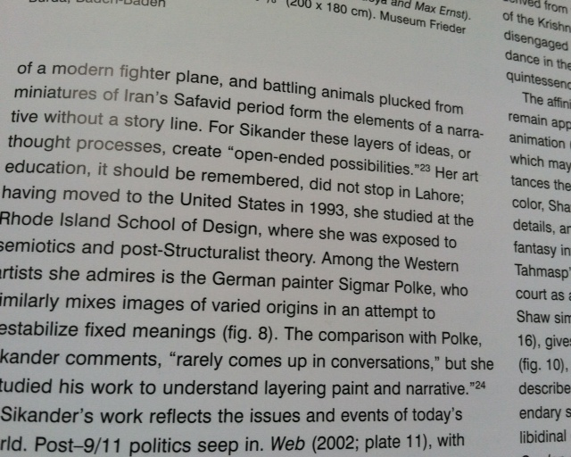
Sikander commentary

Slide 26
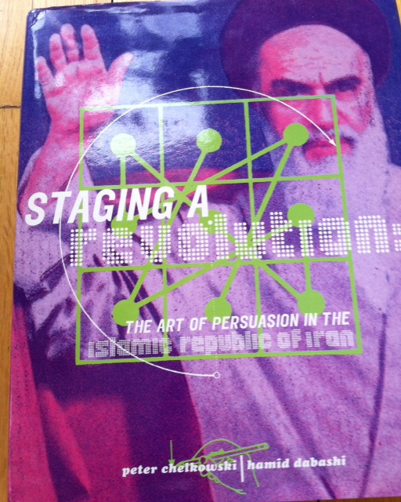
Coffee table book:
Staging a Revolution (1999)
Chelkowski & Dabashi but without Hodgson, Islamicate or Persianate

Slide 27
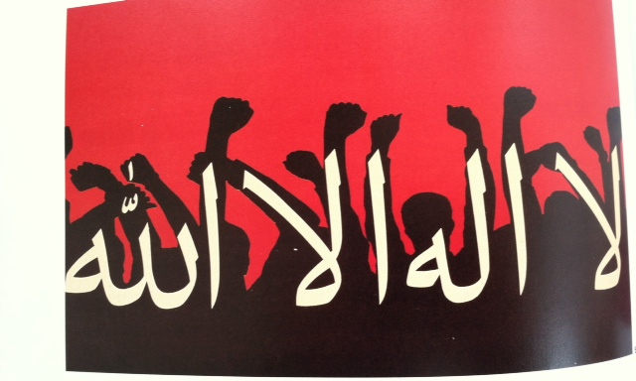
Making the shahada a graphic protest

Slide 28
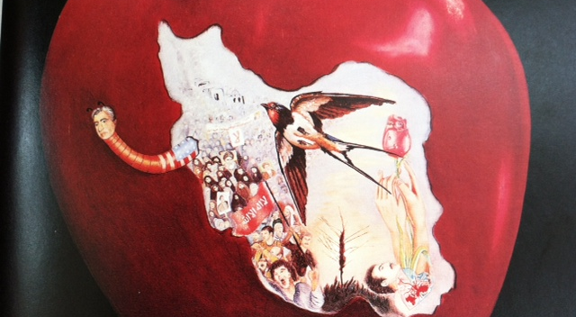
From Sikander to the Shah, natural, animal, vegetable, & human

Slide 29
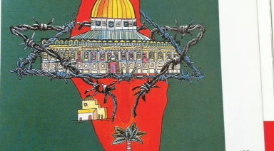
Dome of the Rock barbwired

Slide 30
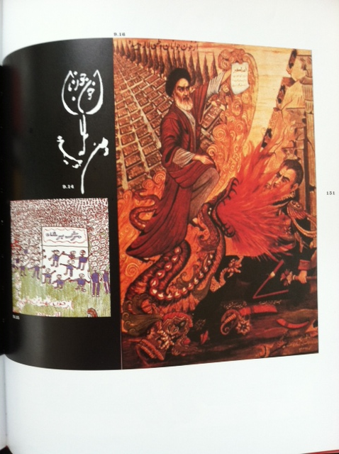
Calligraphic & poetic

Slide 31
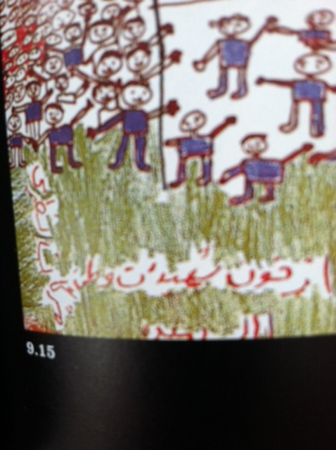
Child’s play – not quite

Slide 32
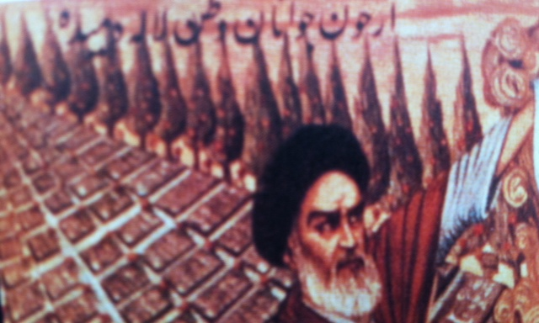
Poet Aref: From blood of
Homeland’s youth spring tulips

Slide 33
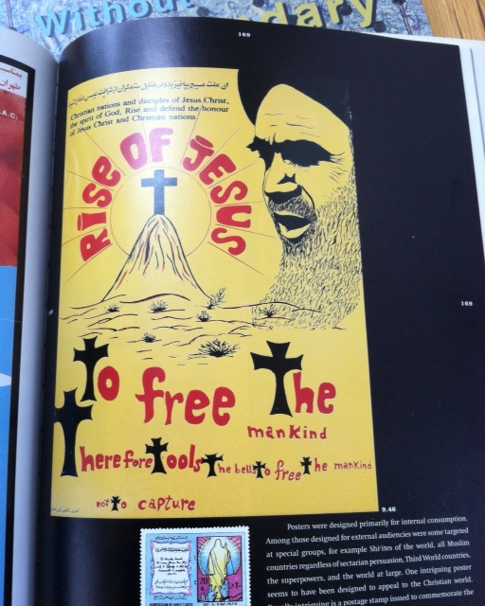
Khomeini’s Appeal to Christians

Slide 34
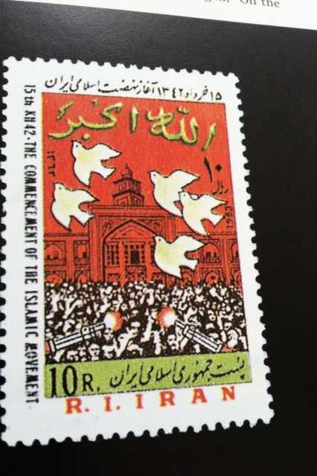
Birds of Freedom

Slide 35
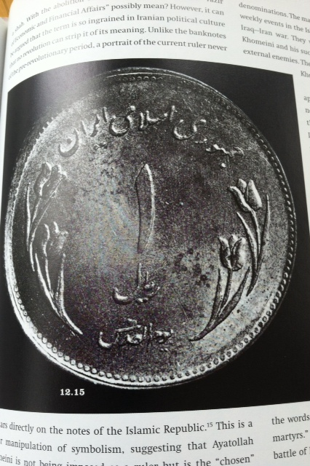
Coins of Hope

Slide 36
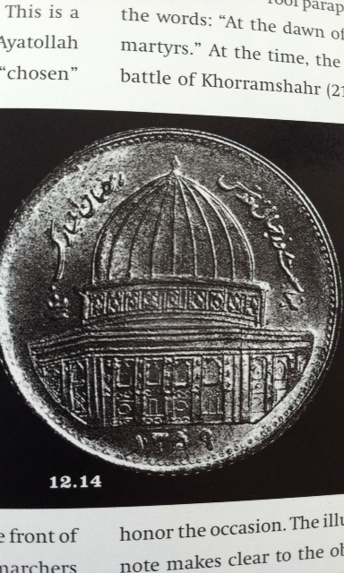
Dome of the Rock in coin

Slide 37
From museum catalogues & coffee table books to critical essays/articles
If Islamicate is absent in museum catalogues & coffee table books, it does find a place in high critical discourse, especially on the legacy of Indo-Persianate poetry and art.
A recent example is Nauman Naqvi, “Acts of Ascesis, Scenes of Poesis” in Diacritics 2012, re the Pakistani poet-painter Sadequain. Islamicate is foregrounded, but chiefly in the
densely argued footnotes, see n. 7 & 8

Slide 38
Naqvi Diacritics # 2
7] The primacy of poesis in Islam is, to begin with, given linguistically in Arabic in the very word for poesy, shi‘r (in Hindi/Urdu, sher). Regarding the place of poesy in Islam, belatedly coming to be recognized, see e.g., the two volumes of Neuwirth and Bauer (eds.), The Ghazal as World Literature (2005). A very moving testimony in this regard is that of the Tunisian thinker, Abdelwahab Meddeb: “The legacy of Islam consists in the profusion and intensity of its body of spiritual texts. This legacy owes as much to the ardor and intensity of its poetic and lyrical sayings as to the exalted tenor of its speculations.” Meddeb, Islam and its Discontents(2003), p. 42. (implicitly Islamicate not Islamic)
8] For the intimacy of mimesis and poesis in the Islamicate, and the primacy of the latter over the former, see the inspiring recent monograh by Minissale, Images of Thought: Visuality in Islamic India 1550-1750 (2009), as well as Barry, Figurative Art in Medieval Islam(2004).

Slide 39
Minissale minus Islamicate
^{The} reference to Minissale is worth noting, since his book delves deeply ^{into} the mindset of Mughal miniature painters. They are fond, he observes, of popular scenes that deal with the aesthetic philosophical issues of art making and the nature of visual representation. Images within images, representations of painters painting, self-portraits, presentation of paintings within the painting and all possible forms involving the process of duplication constitute patterns of reflexivity. Such patterns are loaded with symbolic significances related to aesthetic consciousness in the Mughal context. Yet nowhere does Minissale touch on Islamicate or Persianate categories in analyzing Mughal aesthetic consciousness.

Slide 40
Naqvi # 3
Sadly if one looks at the actual text of the Naqvi article for some insight into Islamicate or Islamicate aesthetics in South Asia, one is similarly disappointed. There is but a single, solitary reference:
“The artist’s violent kenosis as the price of poesis has as its background the colonial-modern deploration of the craft of calligraphy and of the traditional lyric (the premier Islamicate literary genre of the ghazal), a deploration that manically intensifies the melancholy question of inheritance in its relation to the truth and work of askesis and poesis.” (p. 5)

Slide 41
A happier Islamicate note
I could end with the violence of askesis/kenosis/poesis as a colonial denial of the Islamicate, but instead, I would like to close by illustrating a different trajectory of Islamicate aesthetics, its slow re-emergence in the future work of a young Bengali-American art historian. Here is Sugata Ray. He focuses on a single object, a Rajasthani Krishna-Radha shrine that is now part of Doris Duke’s collection at Shangri-La:
see https://vimeo.com/73413831
In the first 7 minutes of this 10 minute clip, there is no mention of Islamicate, yet the object comes from Jaipur, and it was the temples of Jaipur that were analyzed by Catherine Asher (see slide 17) in her contribution to Gilmartin/Lawrence 2000, and so it is more than mere coincidence that Ray is a PhD graduate from Minnesota where one of his teachers was Catherine Asher.

Slide 42
The penultimate hope
The lapse in genealogical attribution will be remedied in a future project described on Ray’s webpage (http://www.sugataray.com) as:“engagement with the artistic cultures in medieval South and Central Asia in order to reconfigure the cosmopolitan aesthetics of the Islamicate through geospatial registers. This project aims to engender a denser, more fractured history of cosmopolitanism/s that moves beyond exceptionalist narratives of the temporal and spatial singularity of Enlightenment cosmopolitanism.”
And, I might add, that Ray’s goal converges with the goal of this conference: to expand not just Islamicate aesthetics but Islamicate cosmopolitanisms as a domain of Islamic --or should we say, Islamicate? – studies. Thank you.

